Slide 1
CSDP-499 Codrone Sim
Week #3
Nyles, Muna, Ali, Success, Sopuru

Slide 2
R1 Interagator - Muna
Task: Sprint Leading
- Sprint planning with Stories
- Sprint Retrospective and Review

Slide 3
R2 Build - Ali
Task:
- Verify that our project works on a fresh install
- Validate on a second machine

Slide 4
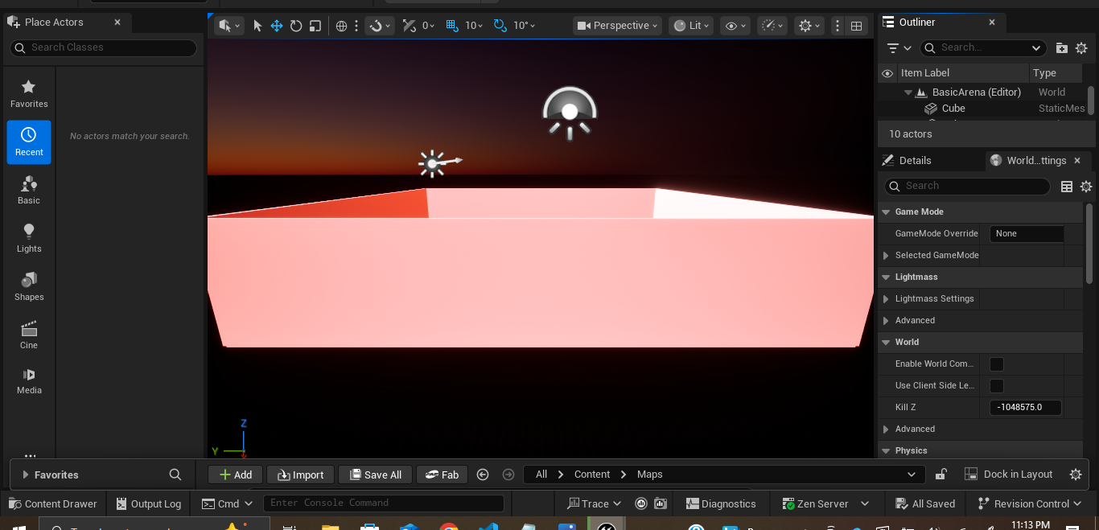
R3 World - Success
Created our 3d Drone environment in Unreal

Slide 5
R4 API - Sopuru
Created Our Template PROTOCOL.md and updated the file with current messages.
Began implementing Messages Between the SDK and unreal

Slide 6
R5 SDK - Nyles

Slide 7
Retrospective
What Worked:
  Consistent Meeting times drastically improved productivity.
  New Golden Machine runs unreal well and we can setit up with little issue.
What Didn’t Work:
  Unreal ran poorly on many of our machines if it ran at all.
  Microsoft AirSim SDK is outdated and no longer receiving updates.
    Forces us to use outdated python versions and dependencies.
    Inconsistent set up
      Some machines are straight forward others do work no matter what.

Slide 8
Deliverables
docs/sprints/W03/plan.md
examples/00_sdk_smoke.py
3d Drone Drone Model inside Project
docs/PROTOCOL.md (updated to match implemented messages)

Slide 9
What we plan to change next sprint
Migrate to Project AirSim
  The Successor to Microsoft Airsim Managed by IAMAI.
  That’s pretty much it!!

